Slide 1
Modeling of the Resilient Basing – Agile Combat Employment Problem

Slide 2
Problem Background
Enemy (ENY) Long Range Precision Munitions (LRPM) present a challenge to US Power Projection in the INDOPACOM Region. Bases traditionally viewed as safe havens are within the range of LRPM.
Technological Advances in LRPM reduce the effectiveness of existing US Air Defense assets.
Resilient Basing (RB) refers to the problem of deciding what defensive investments to make to preserve the US ability to project power in the INDOPACOM region despite ENY LRPM Capability
Agile Combat Employment (ACE) refers to the operational concept of small groups of aircraft dispersing away from main bases, as a form of preserving combat power in the face of LRPM attack
In sum, this is the RB-ASE problem.

Slide 3
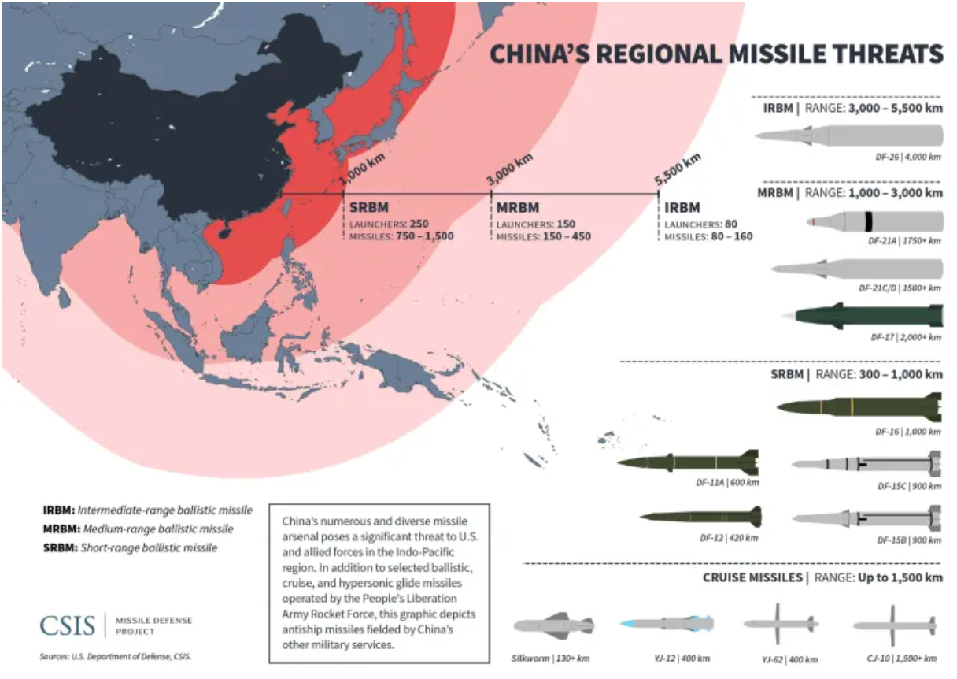
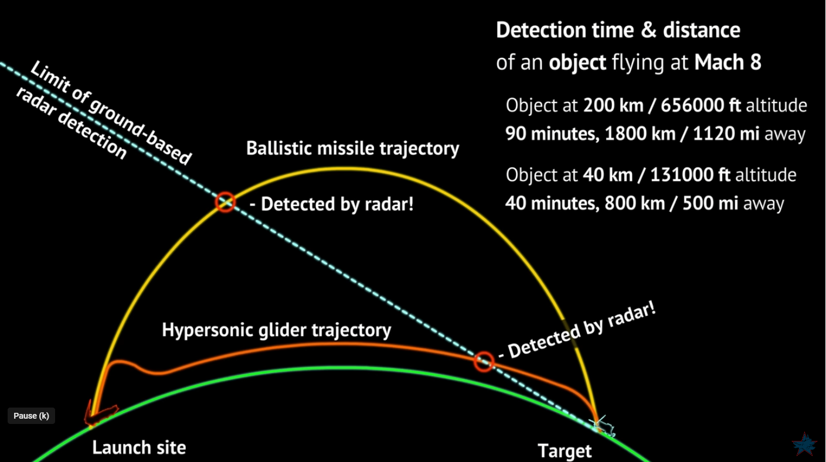
Visualizing the Problem
China’s DF-17
Russia’s Zircon

Slide 4
Primary Stakeholders
CSAF:
Base infrastructure and personnel vulnerable to LRPMs
Access to partner nation assets
Effective cost solution
Ability to attack in moments
Solution desired from DAF
Increase joint/multinational cooperation
Adequate Airbase coverage
ACE
Indo-PACOM:
- Command and control – clear coordination and communication lines between joint services
Provide viable COAs to the Commander in Chief
Maximize joint force lethality
Cost effective operations
Posturing to prevent adversary air and sea control
Implement innovative and experimental scenarios to counter adversary capabilities
Increase interoperability
Synergy among all sister services in Theater to achieve national war objectives.

Slide 5
Secondary Stakeholders
Secondary Stakeholders | Values
DLA | Movement of equipment, personnel, munitions and acquisition of assets
OSD CADE | Cost approval of implementation
J-Staff | Wants their equivalent Warfighter Function to be FMC
Sister Services | Force employment

Slide 6
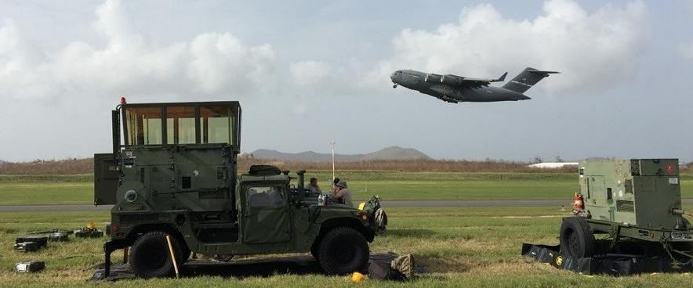
Current Literature
What is ACE?
Air Force Doctrine Note 1-21: Agile Combat Employment (23 Aug 22) Department of the Air Force Operational Imperative-5 (12 Sept 22)
With reduction in global footprint and advancement in adversarial technologies, ACE is a new basing concept to address these challenges.
ACE’s core operational elements: posture, C2, movement and maneuver, protection, sustainment, information/intelligence, and fires.

Slide 7
Current Literature
Operational Imperative: Investing Wisely to Bolster US Air Bases Against Chinese and Russian Attacks. RAND Corporation (2023)
US Air Force bases are vulnerable based on clustered runways, fuel and assets.
Advocates for an active/passive defense portfolio
Balance cost effective measures with offensive/defensive posture
Dispersion increases ability to conduct air operations while under attack
Distributed units with sufficient support are key to effective ACE
Appropriately positioned supplies, political partners and assets will drive survivability rate and effectiveness of counter attack

Slide 8
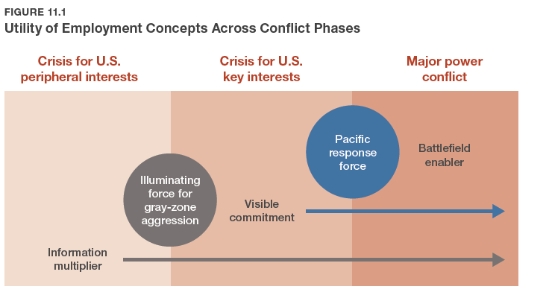
Current Literature
New Directions for Projecting Land Power in the Indo-Pacific: Contexts, Constraints, and Concepts. RAND Corporation (2022)
To Stay Relevant in a China-Focused Scenario, this study suggests that the Army ought to become a “Battlefield Enabler” and “Information Multiplier” to the joint force

Slide 9
Current Literature
Arrol, Matthew, (2022) “The Key to Maximizing the Air Force’s Agile Combat Employment Concept? The Army” Modern War Institute at West Point.
Air Force and Army should work more closely together to build ACE.
Joint investment will enhance defense of forward bases.
Lessons from Ukraine should be used to improve implementation.
Air Base Defense: Rethinking Army and Airforce Roles and Functions. RAND Corporation (2020)
The misalignment of service responsibilities and priorities for air base defense is hindering the correction of enduring shortfalls.

Slide 10
Framework: Resilience to LRPM Attack
Air Force Resilience to LRPM
Cost w/out Joint/Multinational Considerations
Joint / Multinational
Lower the cost of ‘adding bases’ by using existing facilities from Joint/Multinational Partners
Increase interoperability
Maximize joint force lethality
Cost of Building New Bases
Cost
Cost of Building New LRPMs
Flexibility
Cost
Army Point Defense
Joint Doctrine
C2
Number of Bases
Improve Existing Base Infrastructure
Acquisitions
Cost + Joint/Multinational Considerations
AF ADA
Training/Doctrine/Force Structure
Innovative Combat Support Systems
Ability to attack in moments
Cost of Using
LPRM Missiles
Cost +
Diplomatic Cost
Cost of Co-opting
Existing Bases
*Diplomatic Cost
Number of Bases

Slide 11
Problem Frame
What is Desired: Sets of Investments that the Air Force, or DoD Joint Force can make that promote the preservation of combat power in INDOPACOM despite the threat of ENY LRPM. Combat Power measured in “Post-Attack Sorties Available” (PASA)
Inputs:
Sets of investments or actions that the force can take to either make bases resilient or enable ACE
Costs of the various investments / investment portfolios and their constituent parts
Some method to contextualize the effectiveness of the inputs, given some level of LRPM attack
Output: Distributions of PASA at various cost-points of investment
Goal: Maintain the ability to launch retaliation sorties shortly after an Attack with a mix of cost-effective investments

Slide 12


Modeling Approach
1. Develop portfolios of investment at different price points with MDKP.
Reflect costs
Capabilities that lead to sortie generation
What goes into a sortie?
Sortie
Bases
Austere Bases
Main Bases
Support Bases
2. Subject portfolios to LRPM attacks of fixed magnitude
$$P_{k}=P_{find}P_{fix}P_{hit}(1−P_{def_{intercept}})$$
Assets
Runways
Fuel
Maintenance
Ammo
C2 systems
ADA
A/C
3. Calculate PASA

Slide 13
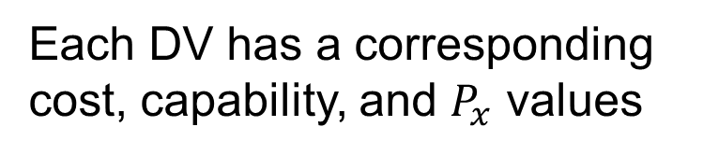
Modeling Approach
1. Develop portfolios of investment at different price points with MDKP.
Reflect costs
Capabilities that lead to sortie generation
Assets
Runways
Fuel
Maintenance
Ammo
C2 systems
ADA
A/C
**Sheltered?**
Runways
Taxiways
Rapid Runway Repair
**People
**Support Equipment
Comms
Mission Planning
Decision Variables (Binary)
2. Subject portfolios to LRPM attacks of fixed magnitude
Fixed Fuel
Fuel Bladders
Resilient Distribution Infrastructure
Ammo
ADA Systems
$$P_{k}=P_{find}P_{fix}P_{hit}(1−P_{def_{intercept}})$$
3. Calculate PASA
Each DV has a corresponding cost, capability, and $P_{x}$ values

Slide 14



Modeling Approach Part 1
Develop portfolios of investment at different price points with MDKP.
Reflect costs
Capabilities to generate sorties
$$Portfolio Cost=cost ∗porfolio$$
constraints
portfolio
$$\left[\begin{matrix} & ⋯ & \\ ⋮ & ⋱ & ⋮ \\ & ⋯ & \end{matrix}\right]$$
Key Things for Constraints
Some way to eliminate non-sensical portfolios (investing too much in only one area, not leading to overall increased PASA)
Existing capabilities cost zero, always included in the basis

Slide 15


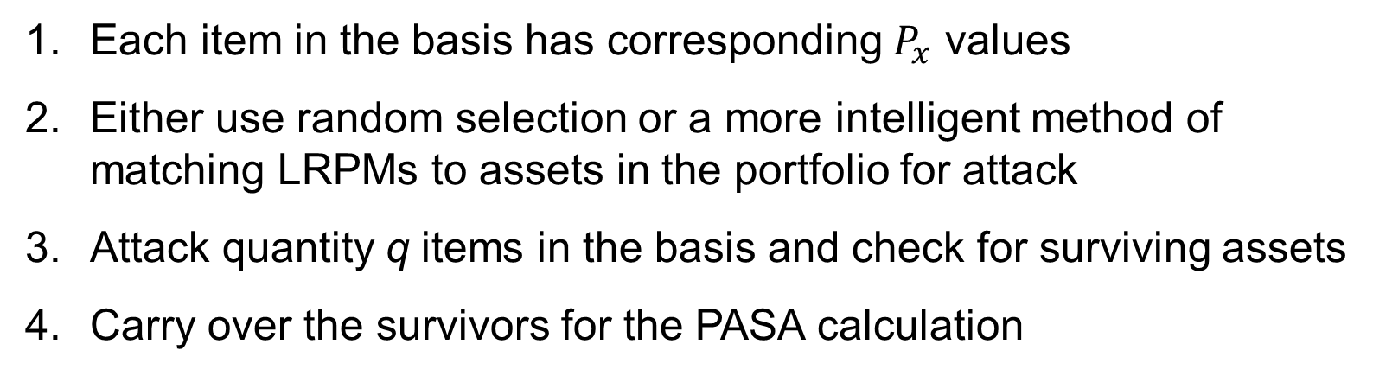
Modeling Approach Part 2
2. Subject portfolios to LRPM attacks of fixed magnitude
Portfolio
$$P_{k}=P_{find}P_{fix}P_{hit}(1−P_{def_{intercept}})$$
Each item in the basis has corresponding $P_{x}$ values
Either use random selection or a more intelligent method of matching LRPMs to assets in the portfolio for attack
Attack quantity q items in the basis and check for surviving assets
Carry over the survivors for the PASA calculation

Slide 16
Modeling Approach Part 3
3. Calculate PASA
PASA = 0
PASA = some quantity
Base 1
Base 2
Limiting Constraint
Runways
Fuel
Maintenance
Ammo
C2 systems
ADA
A/C
Runways
Fuel
Maintenance
Ammo
C2 systems
ADA
A/C
How to measure the level of each of the inputs? Possible to create a yellow category?

Slide 17
Goal Model Output 1
Best Porfolios At Certain Price Points
PASA
0
Portfolio Cost
Insight: At what level of cost do we begin to see results?

Slide 18
Goal Model Output 2
Porfolio Comparison at Specific Price Points
PASA
0
Portfolio Cost
Insight: Which investments make the most difference?

Slide 19
Where am I at now?
I’m still thinking about where the value add it on this problem
As of this morning, I found the set of RAND models that provide broad answers to this type of problem.
So I’m back to the drawing board…. But I’m interested in the joint and geopolitical domain of the problem.
How to cooperate across joint services and partner nations to enable air outcomes in INDOPACOM?
How to build the modular packages that might enable ACE in INDOPACOM?

Slide 20
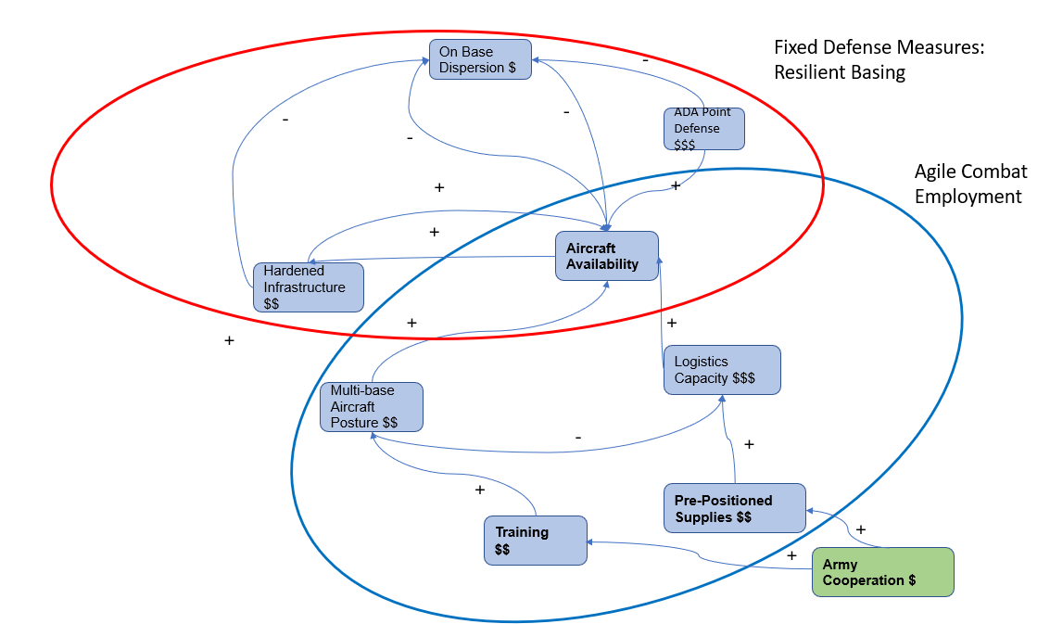
Causal Diagram
Theatre-Level Resolution
X number of Aircraft are located in INDO-PACOM
Chinese launch a Surprise LRPM strike of Y missiles
Goal: Have some level Z aircraft available after the strike
Level Z of aircraft influenced by the factors on the causal diagram

Slide 21
Questions?
What are your thoughts?

Slide 22
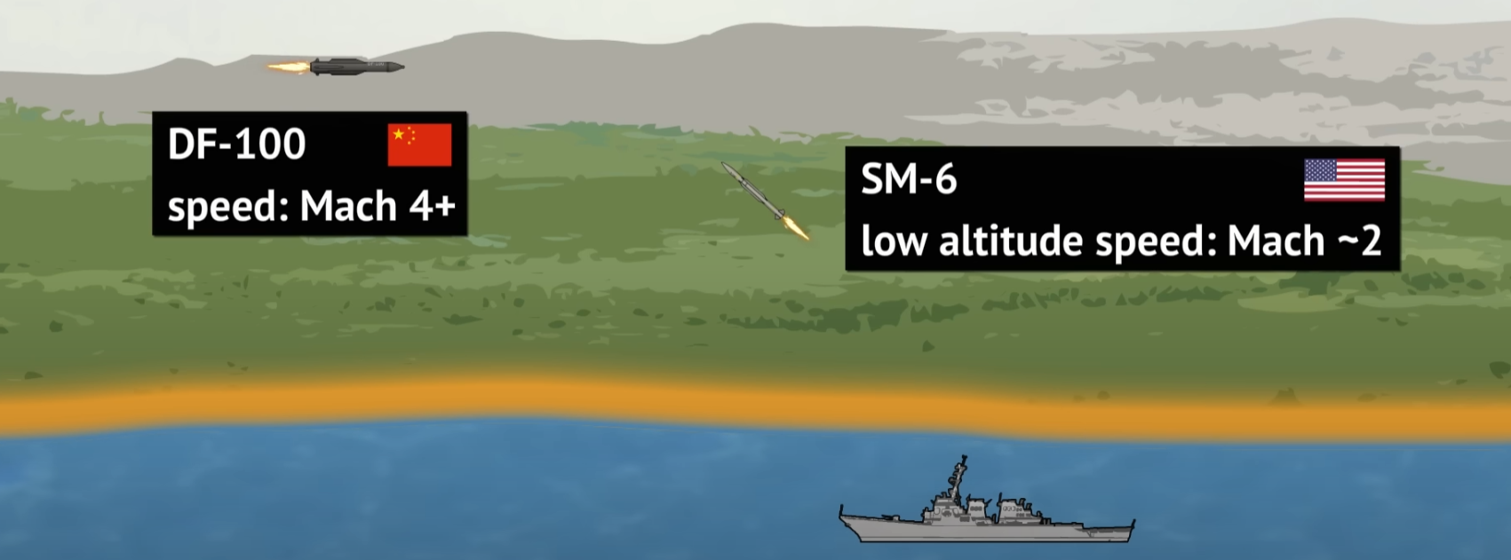
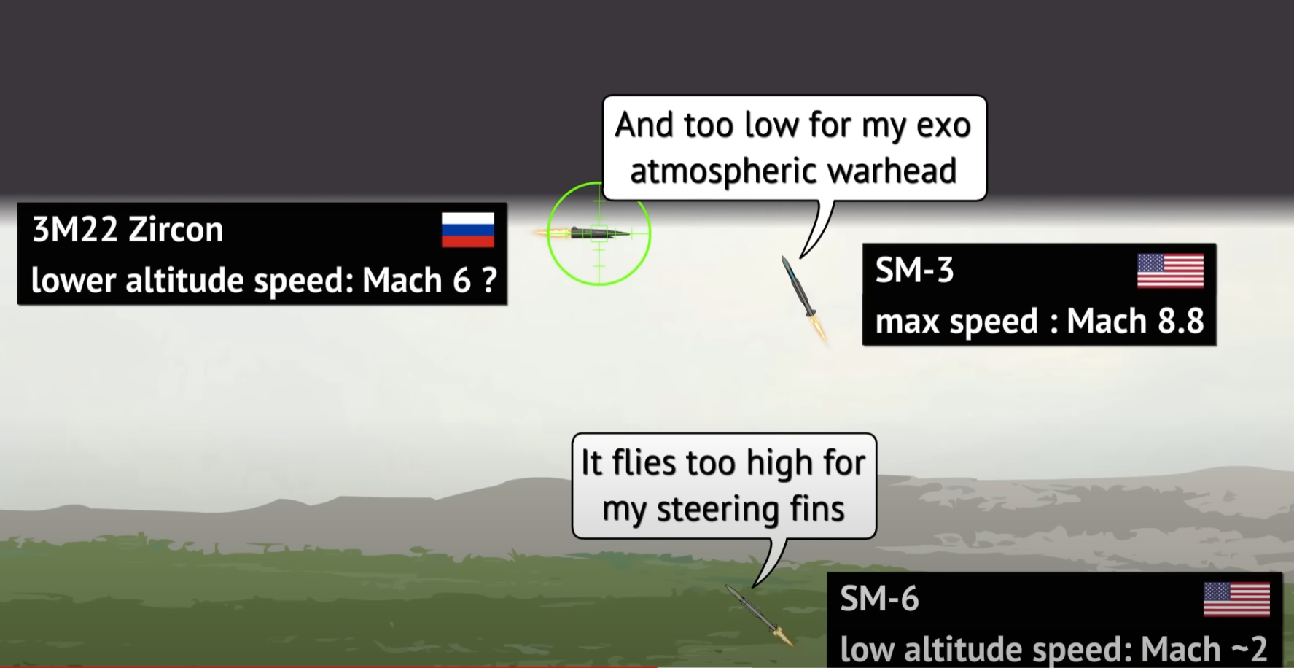
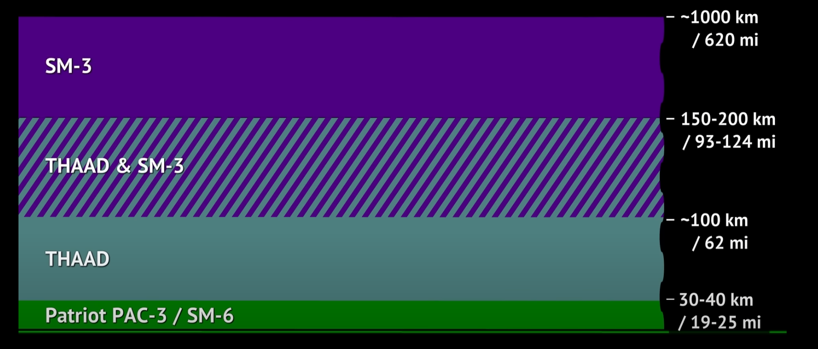

Slide 23
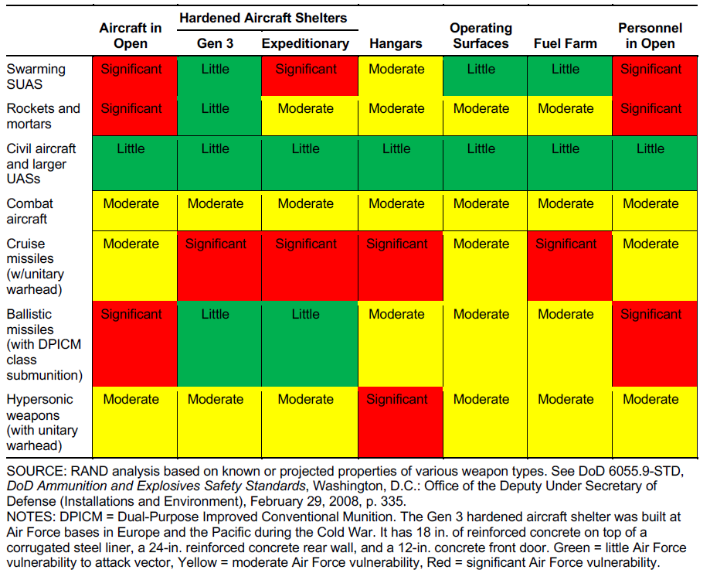

Slide 24

Visualizing the Problem

Slide 25
